Slide 1
BASAL GANGLIA AND ACTION SELECTION
Cansu Küçüksözen

Slide 2

Tourette Syndrome

Slide 3
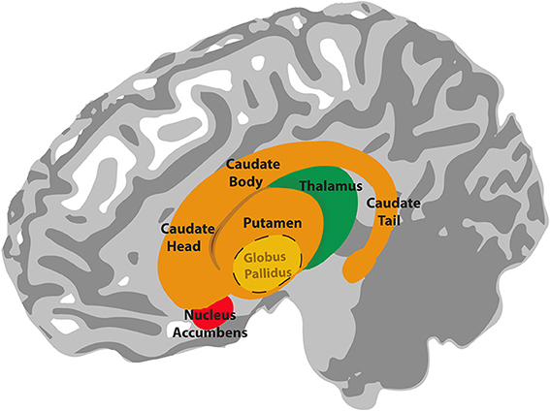
WHAT IS BASAL GANGLIA?
Input: Striatum (caudate, putamen, ventral striatum)
Striatum D1
Striatum D2
Input: Subthalamic nucleus (STN)
Globus pallidus:
Output: Internus (GPi)
Externus (GPe)
Known for: motivational behavior, reinforcement learning, coordinating and initiating movement, action selection etc.
Connections: Substantia nigra (SN), motor cortex, thalamus, and various areas in cortex
Medium Spiny Striatal neurons

Slide 4
ACTION AND ACTION SELECTION
Action: “the fact or process of doing something, typically to achieve an aim” (New Oxford)
Action → Behavioral expression determined by populations of cells in BG → channels (Gurney et al., 2001)
Associated with elemental motor acts or behavioral strategies.
Action selection: selecting certain actions (and suppressing others) for appropriate behavior to occur (Gurney et al., 2001)
Effective action selection → Central Switching & Selection device = Basal Ganglia
Original model by Albin et al. (1989)
but the interaction between pathways were not clear and did not take STN’s connections into account

Slide 5
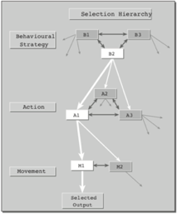
ACTION SELECTION PROBLEM
Problem of selecting between competing behavioral choices or alternatives for actions
Hierarchical decomposition of selection
conflicts between competing systems emerge
Appropriate combinations of multiple actions require both simultaneous and sequential activity of output systems.
Higher level of control disambiguates between appropriate and inappropriate combinations of lower level selections.
(Redgrave et al., 1999)

Slide 6
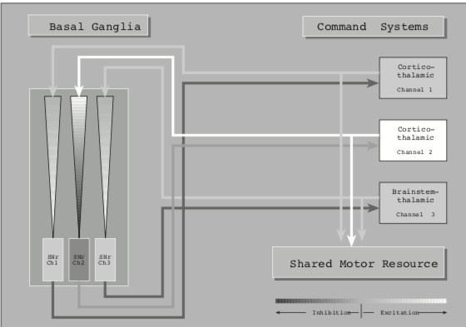
CENTRAL SELECTION DEVICE = BASAL GANGLIA
Multi-channel Architecture
Restricted motor resources between competing demands.
Access to motor system is given for most salient input.
Selection device→ enables connections between the winning command and the motor plant while simultaneously denying access to the losers.
The tonic inhibitory output from the basal ganglia to thalamus blocks the direct connections between command systems (at all hierarchical levels) and the motor plant
(Redgrave et al., 1999)

Slide 7
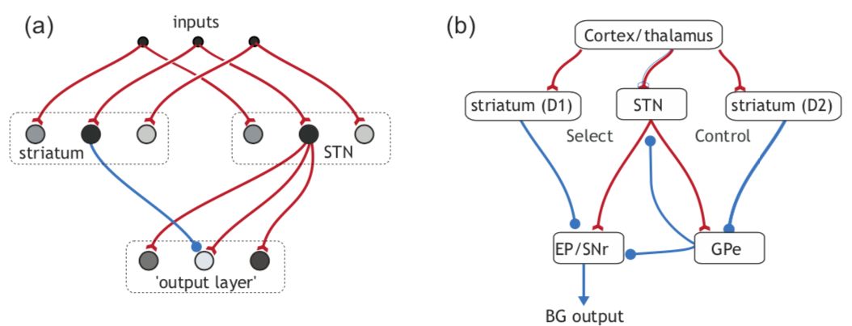
GPR MODEL (Gurney et al., 2001)
+
Signal selection → each action has scalar-valued signal = salience.
Action selection→ signal selection of the largest salience-signal inputs (which is the low signal output at GPi)
Direct pathway = Selection pathway (facilitating)
Indirect pathway = Control pathway (suppressing)
Later research → Hyperdirect pathway
Net effect→ Selection and control pathways inhibit the GPi (disinhibition*) so that an action is selected
Hard switching / Soft switching
+
+
+
+
—
—
—
GPi
Blue: inhibitory connections
Red: excitatory connections
—
Thalamus
Gurney et al., 2001; Humphries & Gurney, 2021

Slide 8
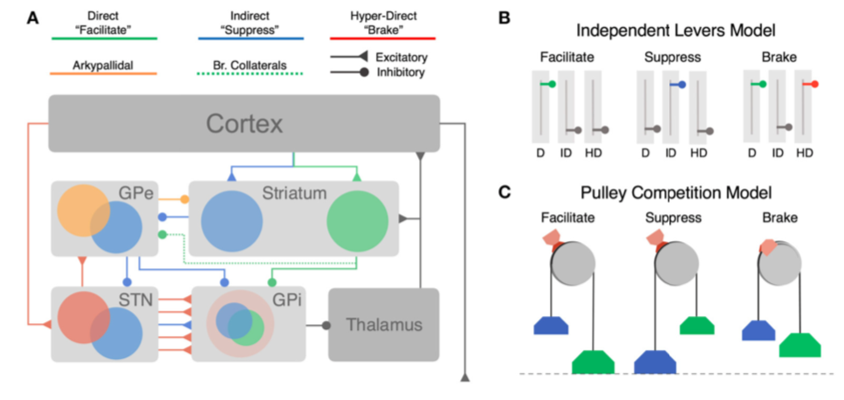
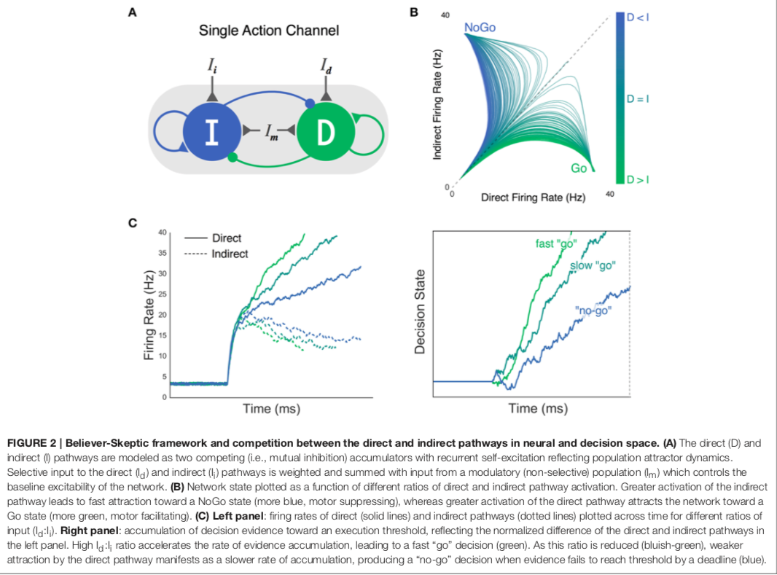
BELIEVER-SKEPTIC FRAMEWORK FOR DECISION-MAKING
- 3 pathways are not independent, they compete with each other during each action
-Believer-Skeptic framework: dynamic competition (of action facilitating and suppressing states) through a decision threshold (switching mechanism: accumulating evidence → action execution)
(Dunovan & Verstynen, 2016)

Slide 9
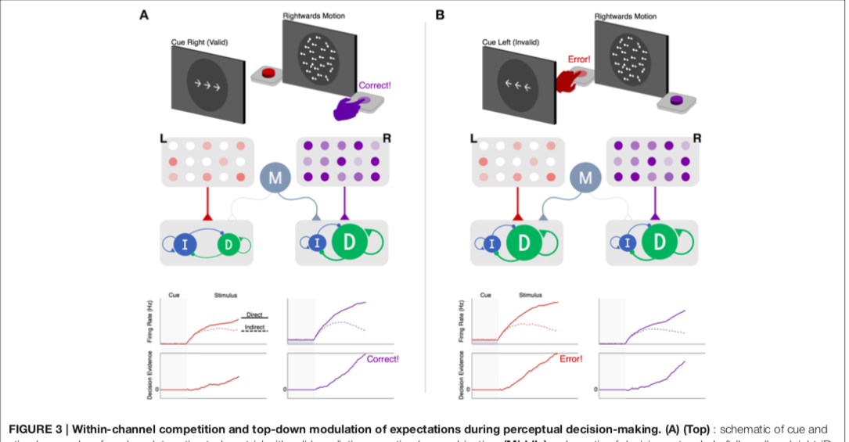
EXAMPLE FOR DECISION-MAKING

Slide 10
REINFORCEMENT LEARNING
Dopaminergic connections within Basal Ganglia structures
Increase in dopamine is a reward that:
Sensitizes dMSNs (direct pathway medium spiny neurons)
Desensitizes iMSNs (indirect pathway medium spiny neurons)
Results in reinforcement learning → tendency to repeat that action in the future

Slide 11
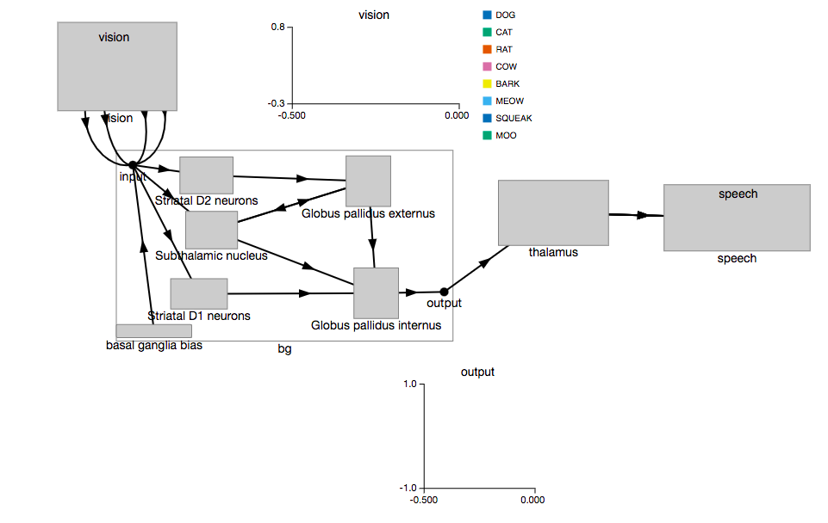
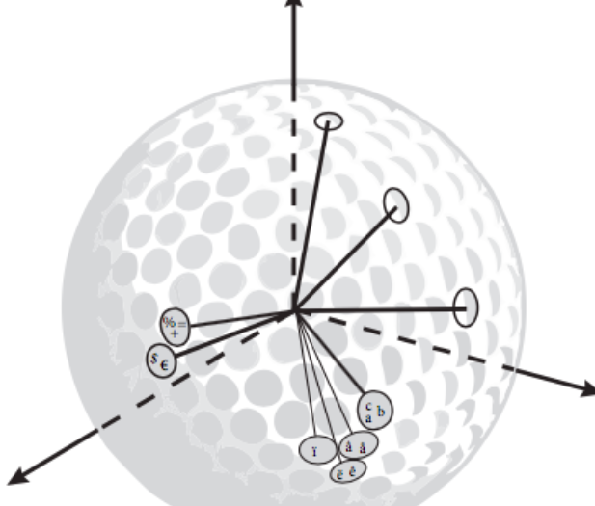
NEXT STEP: NENGO MODEL OF BASAL GANGLIA
Semantic Pointer Architecture in Nengo (SPA)

Slide 12
REFERENCES
Action. Cambridge Dictionary. (n.d.). Retrieved February 15, 2022, from https://dictionary.cambridge.org/dictionary/english/action
Dunovan, K., & Verstynen, T. (2016). Believer-Skeptic meets actor-critic: Rethinking the role of Basal Ganglia Pathways during decision-making and reinforcement learning. Frontiers in Neuroscience, 10, 106. https://doi.org/10.3389/fnins.2016.00106
Gurney, K., Prescott, T.J., & Redgrave, P. (2001). A computational model of action selection in the Basal Ganglia: A new functional anatomy. Biological Cybernetics, 84(6), 401- 410. https://doi.org/10.1007/PL00007984
Humphries, M. D., & Gurney, K. (2021). Making decisions in the dark basement of the brain: A look back at the GPR model of action selection and the basal ganglia. Biological cybernetics, 115(4), 323-329. https://doi.org/10.1007/s00422-021-00887-5
Redgrave, P., Prescott, T.J., & Gurney, K. (1999). The Basal Ganglia: A vertebrate solution to the selection problem?. Neuroscience, 89(4), 1009–1023. http://dx.doi.org/10.1016/S0306-4522(98)00319-4

